Slide 1
Our course is Linguistics of discourse

Slide 2
Lecture 5-6
BASIC UNITS
OF DISCOURSE

Slide 3
Questions to discuss
The smallest unit of discourse.
Types of speech act.

Slide 4
Question 1
The smallest unit of discourse

Slide 5
The influence of the pulse duration has to be corrected in the calibration procedure. A laser energy meter not depending on a cw laser radiant power scale is described in [90Yua]. In this instrument the light pressure of the laser beam sensed by two mirrors is converted by a moving coil to an electrical signal. The main advantages of this system are fast response and no interruption of the laser beam. The device has been investigated for single laser pulses of radiant energies between 10 mJ and 6 J. Another method not interrupting the laser beam is the photoacoustic calorimetry [86Kim]. There, the radiant energy incident upon a mirror is absorbed at the mirror surface. The absorbed energy generates elastic strain waves which propagate through the mirror substrate. The strain waves eventually pass through a piezoelectric transducer attached to the back of the mirror substrate.

Slide 6
Is it a word?

Slide 7
Is it a sound (phoneme)?

Slide 8
Is it a phrase?

Slide 9
The only language unit that is used for communication is ...

Slide 10
a sentence!!!!

Slide 11
It is sentences that we use for communication.

Slide 12
The meaning (the function) of the sentence depends on a particular speech situation.

Slide 13
For example

Slide 14
"Why did you do this?”

Slide 15
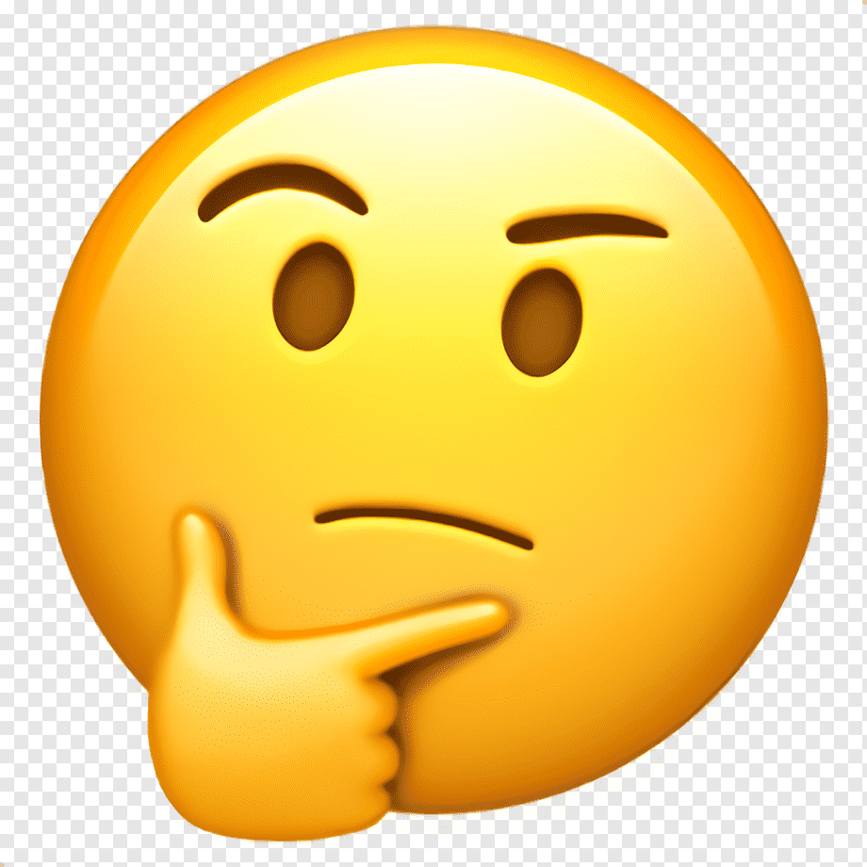
Why did you do this?

Slide 16

Why did you do this?

Slide 17

Why did you do this?

Slide 18
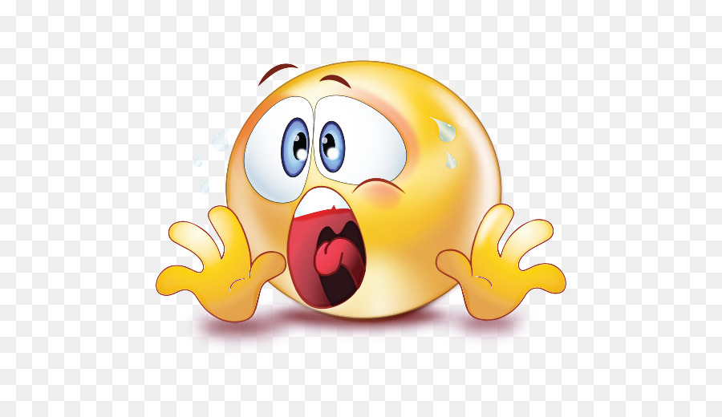
Why did you do this?

Slide 19

Why did you do this?

Slide 20

Why did you do this?

Slide 21
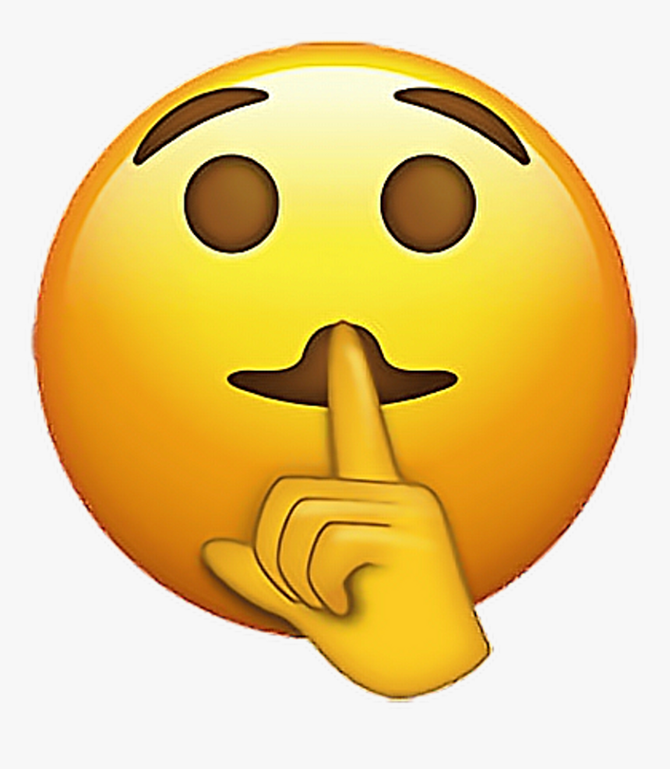
Why did you do this?

Slide 22

Why did you this?

Slide 23

Why did you do this?

Slide 24
Why did you do this?
A question
A surprise
A threat
Advice
Warning
etc., etc., etc.

Slide 25
To interpret a sentence in a proper way, we should take into account the participants of the communication, their intentions, the time and place of the communication and other factors.

Slide 26

Your hair is so long.

Slide 27

Your hair is so long.

Slide 28
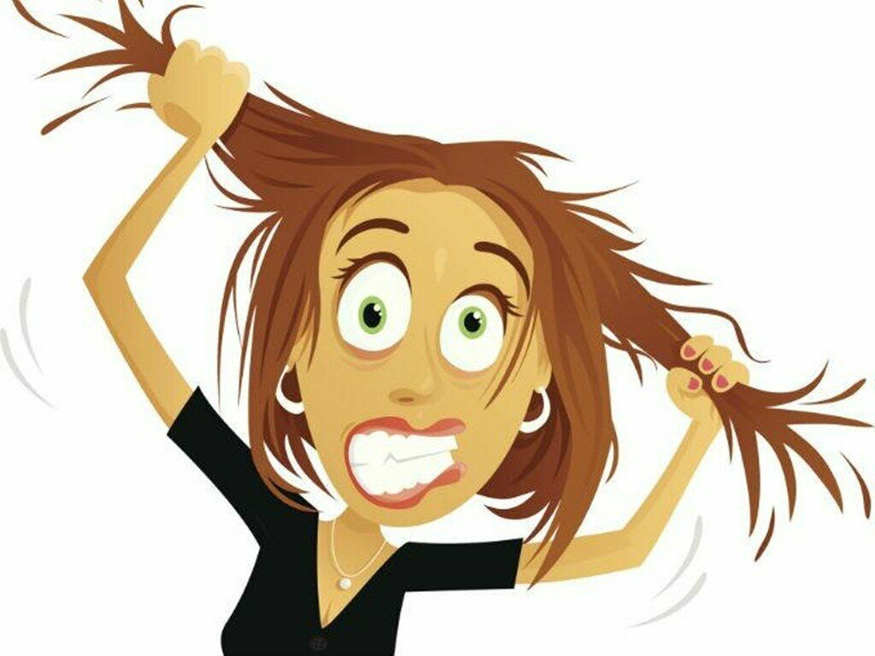
Your hair is so long.

Slide 29
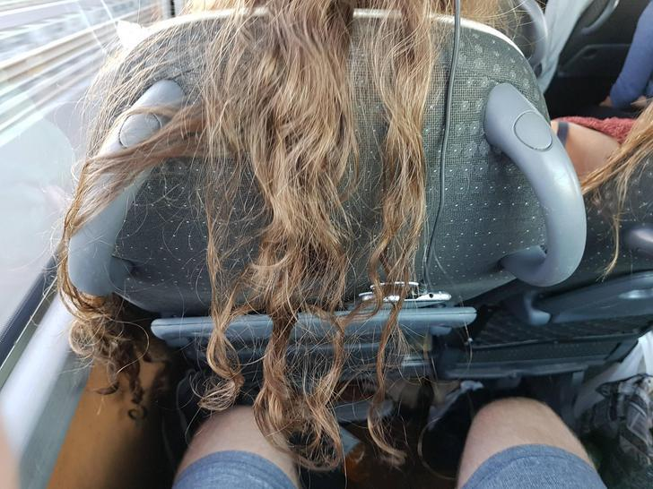
Your hair is so long.

Slide 30
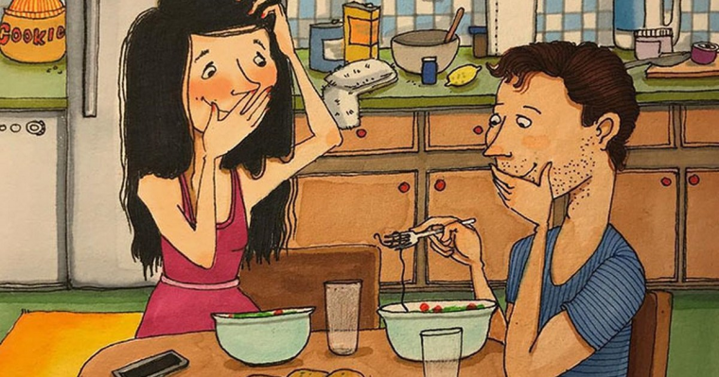
You hair is so long.

Slide 31
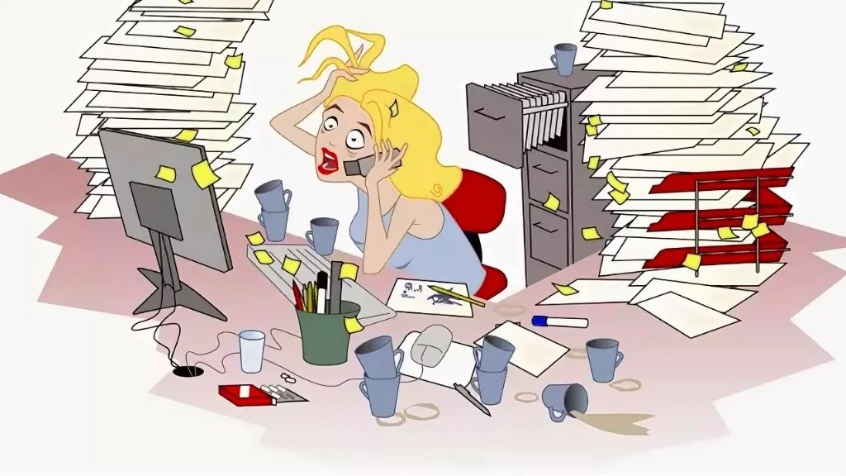
My computer is broken.

Slide 32

My computer is broken.

Slide 33
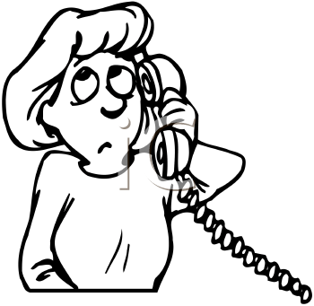
My computer is broken

Slide 34
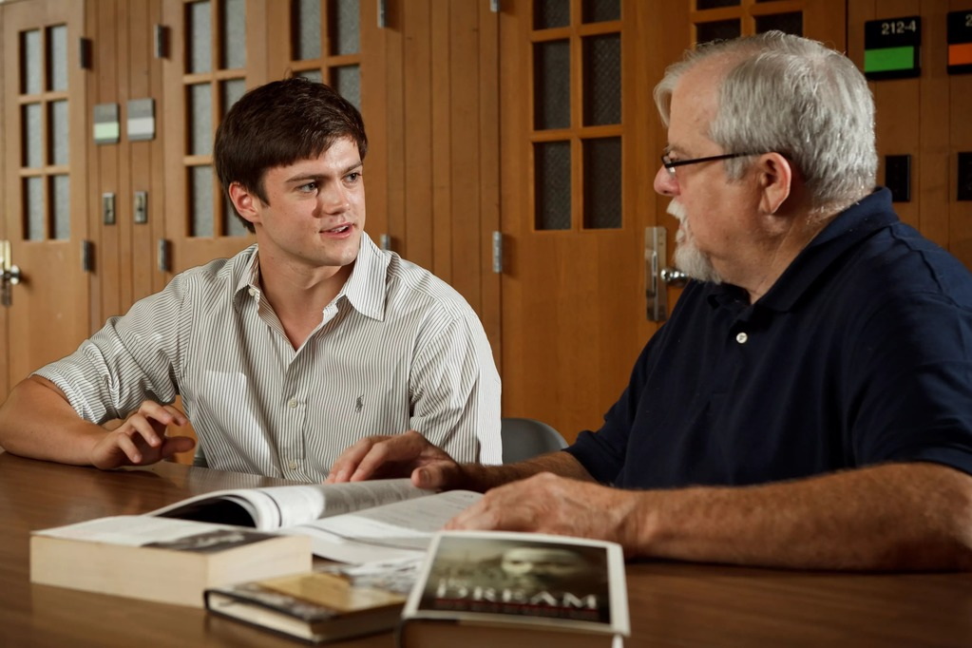
My computer is broken = I am not ready for today

Slide 35
So, a minimal unit of discourse is a sentence.

Slide 36
But linguistics of discourse doesn’t use the term “a sentence”.

Slide 37
Speech act = sentence

Slide 38
In fact, a speech act is a sentence but a sentence as a communicative unit (not a structural one).

Slide 39
So, we use the term “a sentence” to show that it is a structural phenomenon (used for building larger units of the language and speech like a text), while we use the term “a speech act” to show that it is used as a communicative phenomenon (for communication).

Slide 40
Thus, the official definition of “a speech act” can be as follows.

Slide 41
A speech act (an utterance, a message) is an intentional communicative action that takes the form of a sentence.
An illocutionary act = speech act

Slide 42
Examples of speech acts

Slide 43
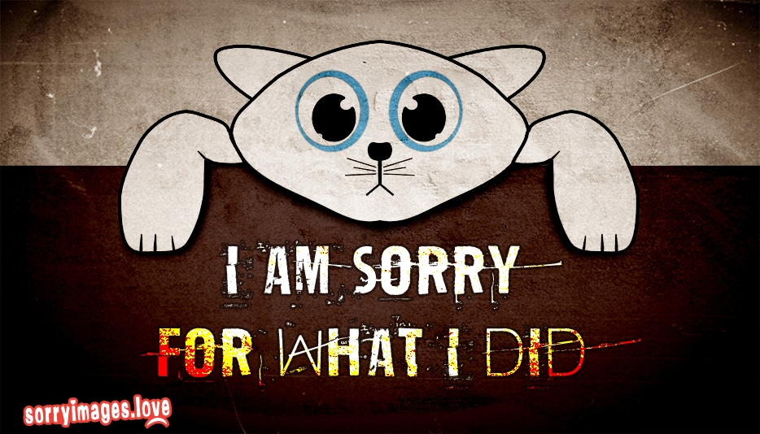
Apology

Slide 44
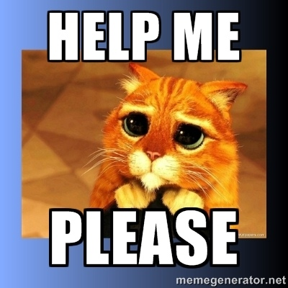
Request

Slide 45
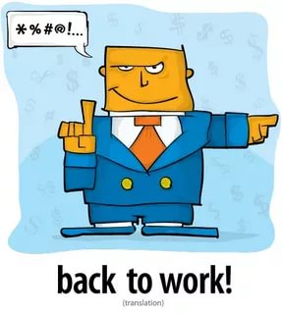
Order

Slide 46
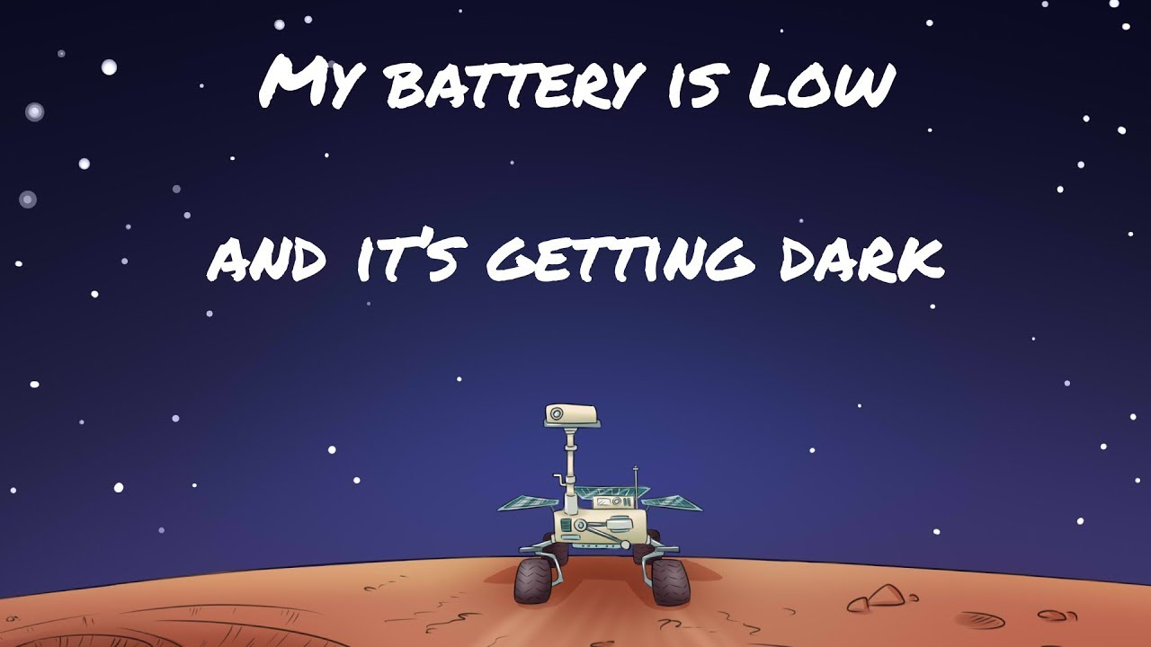
Statement

Slide 47

Invitation

Slide 48
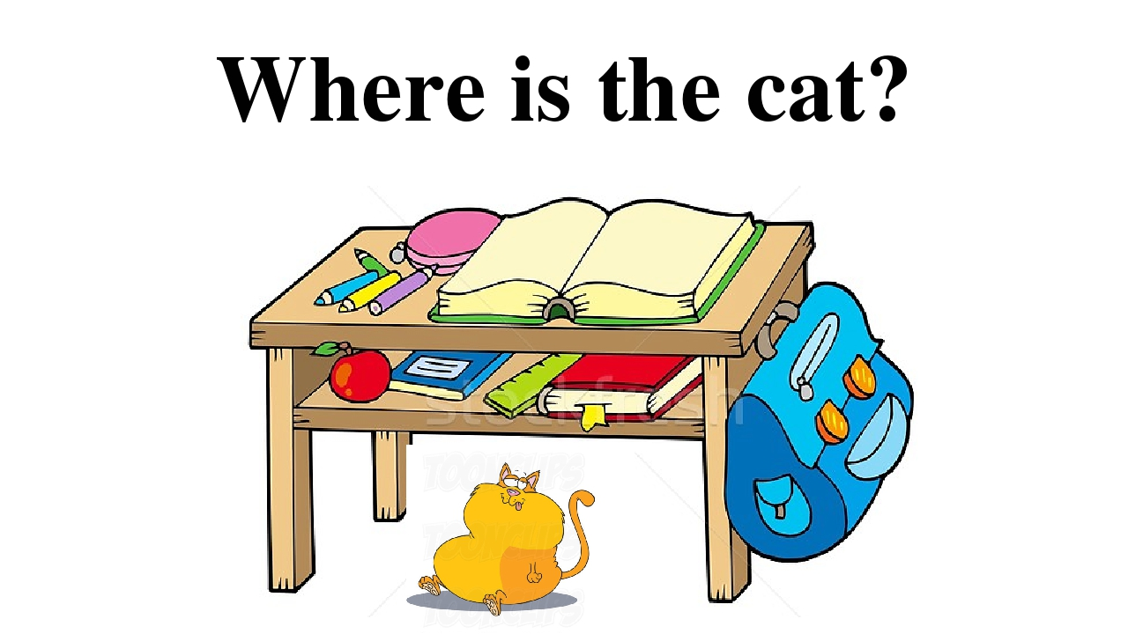
Question

Slide 49
Question 2
types of speech act

Slide 50
Parameters/criteria to classify speech acts:
1) by the communicative goal (illocutionary force/function, intentions of the speaker),
2) by the way the communicative goal is represented.

Slide 51
The criterion “the illocutionary force/communicative goal” helps us differentiate between the following types of speech acts (John Searle and Daniel Vanderveken, 1986):

Slide 52
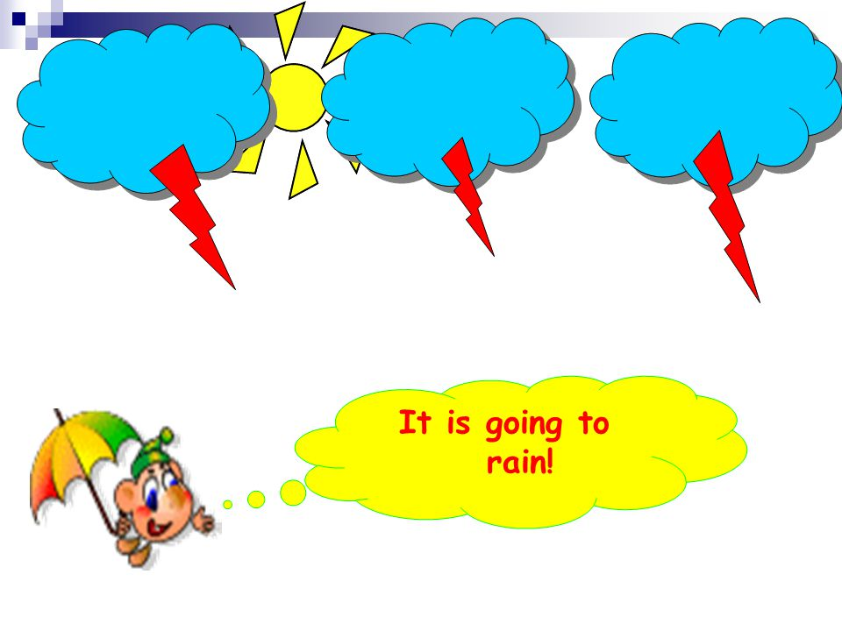
1) assertive/representative – statements (memo, confirmation, disagreement, etc.):

Slide 53
She came back home yesterday.
I don’t think so.
I live in London.

Slide 54

2) directive – speech acts expressing inducement, acts that make us do something, imperative speech acts (request, order, advice, recommendation, demand, command, invitations, etc.):
Please, don’t forget to buy some milk on your way home.
Could you do it for me?
The passengers are welcome to proceed to the boarding gate.
I’m cold.
You should eat more.

Slide 55

3) interrogatives/questions – requests for information:
When are you leaving?
I'd like to know when you'll be back.

Slide 56

4) commissives/promissives – promises, guarantees, etc.
I will be on time.
I'll fix it this weekend.
I will definitely do it!

Slide 57

5) menacive – threat:
You’ll pay for it.
I’ll give away all your secrets.

Slide 58

6) expressives – etiquette speech acts (congratulations, apologies, thanks, expressions of sympathy, greetings, farewells) or exclamations (Haven’t seen you for ages! Time flies!), indignation (How dare you!?), surprise (When did you get married?!).

Slide 59
This classification of speech acts isn’t perfect, because discourse is full of cases of double-nature.

Slide 60
So, the criterion “the illocutionary force/communicative goal” helps us differentiate between the following types of speech acts:
- assertives/representatives;
- directives;
- interrogatives/questions;
- commissives/promissives;
- menacives;
- Declaratives – statement (Our lecture will start a bit later);
- expressives.

Slide 61
What type of speech act is it?
(assertive; directive; interrogative; commissive; menacive; declarative; expressive)
Go and get it!

Slide 62
What type of speech act is it?
(assertive; directive; interrogative; commissive; menacive; declarative; expressive)
I will not let you do that.

Slide 63
What type of speech act is it?
(assertive; directive; interrogative; commissive; menacive; declarative; expressive)
Well, you know how it is... I could tell everything to her if you do not come.

Slide 64
What type of speech act is it?
(assertive; directive; interrogative; commissive; menacive; declarative; expressive)
Congratulations for having achieved this success.

Slide 65
What type of speech act is it?
(assertive; directive; interrogative; commissive; menacive; declarative; expressive)
I end the session.

Slide 66
What type of speech act is it?
(assertive; directive; interrogative; commissive; menacive; declarative; expressive)
I'm sorry I said that.

Slide 67
What type of speech act is it?
(assertive; directive; interrogative; commissive; menacive; declarative; expressive)
If you do not come, I will tell everything to her.

Slide 68
What type of speech act is it?
(assertive; directive; interrogative; commissive; menacive; declarative; expressive)
I'll be there before nine.

Slide 69
What type of speech act is it?
(assertive; directive; interrogative; commissive; menacive; declarative; expressive)
It’s time for dinner.

Slide 70
What type of speech act is it?
(assertive; directive; interrogative; commissive; menacive; declarative; expressive)
By the power conferred by law, now I declare you husband and wife.

Slide 71
What type of speech act is it?
(assertive; directive; interrogative; commissive; menacive; declarative; expressive)
I’m having a birthday party next week.

Slide 72
What type of speech act is it?
(assertive; directive; interrogative; commissive; menacive; declarative; expressive)
There is no better cook than me.

Slide 73
What type of speech act is it?
(assertive; directive; interrogative; commissive; menacive; declarative; expressive)
I bet he will not have the courage to appear before his parents.

Slide 74
The criterion “the way the communicative goal is expressed” helps us differentiate between the following types of speech acts:
direct speech acts;
indirect speech acts.

Slide 75
Direct speech acts are statements in which the speaker means literally what he says.
What time is it?
Please fasten your seat belts.
Pandas don't hibernate.
I pronounce you wife and husband.
I congratulate you on …

Slide 76
Direct speech acts
Performative Non-performative
speech acts speech acts

Slide 77
A performative speech act is an utterance that is used not for describing reality but for changing reality, for doing things.
For example, when Paul says "I promise to do the dishes“, he thereby does not just say something, he makes a promise and, thus, changes reality.

Slide 78
Examples of performative speech acts:
- “I now pronounce you married"
"I order you to go“
"I accept your apology"
"I sentence you to death"
"I divorce you”
"I swear to do that",
"I promise to be there"
“We apologize"
“I declare war"
"I resign"

Slide 79
Performative or non-performative?
I name this ship the Queen Elizabeth.
I conclude that this was the best decision.
Definitely, this was the best decision.
I suggest you go and ask for forgiveness.
Would you be so kind as to pass me the salt?
The best seller in the company is the one that makes the most sales, and I was the one who made the most sales!
I boast of being the best seller in my company.

Slide 80
An indirect speech act is a statement that expresses not only what it directly means, but something else.

Slide 81
For example, an indirect speech act is an act that is formally a statement, but semantically/ functionally it is a directive:
It’s a bit stuffy here. = Open the window.

Slide 82
A speech act can formally be a directive (e.g. advice) but semantically/functionally it’s a menacive:
You shouldn’t have done it = We’ll never be friends again.

Slide 83
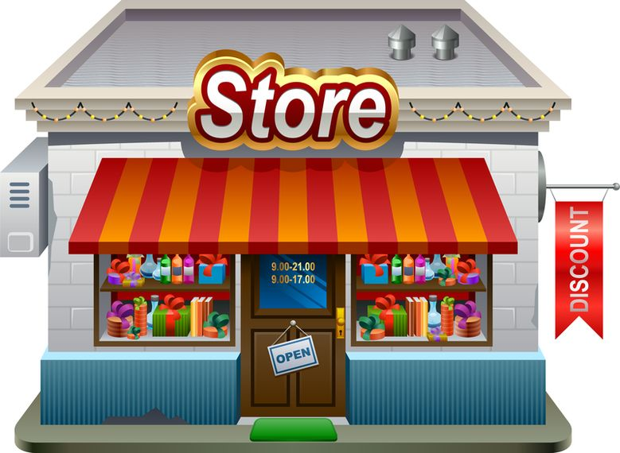
You want you husband (wife) to go to the shop. How can you say it indirectly?

Slide 84
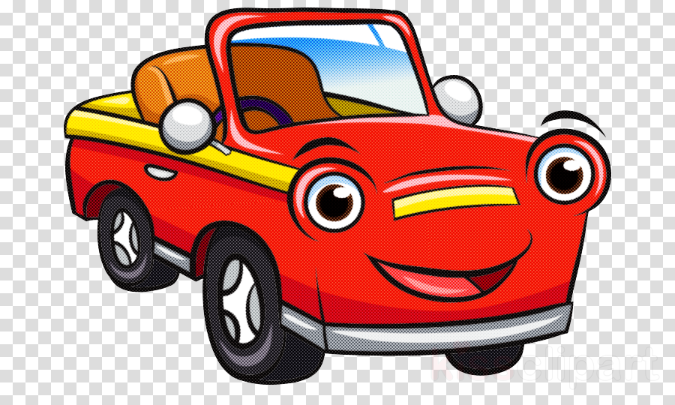
You have to persuade your husband (wife) to buy a car (a new car). What indirect speech acts can help you do it?

Slide 85

Tell you boss (in an indirect way) that you need a holiday.

Slide 86
Indirect speech acts can be of two types:
conventional speech acts
unconventional speech acts

Slide 87
Conventional speech acts are indirect speech acts that can be easily interpreted because their meaning is supported by convention (Could you...?", Would you be so kind...?)

Slide 88
Unconventional speech acts are indirect speech acts whose communicative function can be misinterpreted:
А. Tomorrow is a pay-day.
B. Do you mean that you want to organize a party?
А. No, I simply want to say that I can give you back the money that you lent me last month.

Slide 89
Misinterpretation (complete or partial) of the illocutionary force (communicative goal) of a speech act is known as a communicative (conversational) failure.

Slide 90
Conclusions:
1. The basic communicative unit of discourse is a speech act.
2. The main types of speech acts are:
an assertive
a directive
a promissive
a declaration
an expressive

